Slide 1
Massive MIMO Techniques Applied to 5G
Prof. Mário Marques da Silva
Director of the Department of Sciences and Technologies
Universidade Autónoma de Lisboa
Institute for Telecommunications
Portugal

Slide 2
Outline
Introduction: the 4th Industrial Revolution & 5G Communications
Channel Estimation for Massive MIMO using Precoding
Performance Results
Conclusions

Slide 3
Outline
Introduction: the 4th Industrial Revolution & 5G Communications
Channel Estimation for Massive MIMO using Precoding
Performance Results
Conclusions

Slide 4
Introduction
Industry 4.0
4th Industrial Revolution
Robotic
Artificial Intelligence
Internet of Things
Big Data
Quantum Computing
Quantum Communications

Slide 5

Introduction – The 4th Industrial Revolution
5G Cellular Communications (2020)
  Relates to Internet of Things and will support hiperconnectivity, generating data 20 times faster (20 Gb/s) than with 4G, and with a lattency 10 times lower. Will support point-to-point communications (IoT), instead of only through a Base Station.
Big Data
  Consists of massive quantity of data, structured or non-structured, that requires processing with Artificial Intelligence to generate Knowledge.
Robotic and Artificial Intelligence
  A Robot is used to accomplish a certain task, but requires intelligence → 4th Industrial Revolution

Slide 6
Introduction – The 4th Industrial Revolution
Quantum Computing & Communications
  Moore’s Law is not being followed: The speed of microprocessors duplicates every 2 years.
  Gilder’s Law is not being followed: “the total bandwidth of communication systems triples every twelve months”.
  Quantum Computing & Communications relates with the principles of Quantum Mechanics:
    “Entaiglement”
    Quantum Duality

Slide 7
Future ?????
Economy
Social
Mobility
Housing
Teaching
Health
Introduction
Industry 4.0

Slide 8
Introduction
Industry 4.0
4th Ind. Revolution
Cars: Eletric+Self-Driving+Shared
Self-driving aircrafts
Drones
Medical and Lawyer counselling
War: drones (armed+sensor) + Remotely controlled through Satellite
Industrial Production Chain based on Robotic
Micro-drones → Intelligence
Smart City Applications
Personal IoT Applications
Wild life Monitoring
Logistics
Agriculture
Home Automation and Safety
The shape of the Robot is not an issue.
The future of Robot comprises a shape adapted to its functionality.
Ex: Self-Driving Car.

Slide 9
Introduction – The 4th Industrial Revolution
Self-Driving Cars
  In the Future (15 years) Mobility will be with cars: 1) Electric; 2) Self-Driving; 3) Shared.
Self-driving Aircrafts
Medical and Lawyer counselling
Cirurgies with Robots
Functional Drones and War
  War with Drones, armed and with sensors, controlled through satellite, remotely operated from other parts of the globe
  Micro-drones → Intelligence
Industrial Production Chain based on Robotic
Automatic Translation
Facial Reconnaissance
Intelligent Houses (including vacuum machines, etc.)
Personalized marketing in the Internet
The shape of the Robot is not an issue. The future of Robot comprises a shape adapted to its functionality. Ex: Self-Driving Car.

Slide 10
Aplicações da Robótica / Inteligência Artificial
Implicações Sociais:
  Existem receios de que a 4ª Revolução Industrial traga Desemprego
  Semelhante antecipação ocorreu com as anteriores Revoluções Industriais, nomeadamente com a 3ª (Revolução da Informação -> Tecnologias de Informação e Comunicação)
  Na realidade, parece-me que os receios que se anteveem funcionarão para aqueles que não se preparam para o "novo paradigma", i.e., desaparecerão alguns empregos e aparecerão outros.
  Implicará que estejamos atentos e nos adaptemos. Para aqueles que não se adaptam à nova realidade, existirão consequências laborais, e sociais.
  Mas BIG BROTHER (hoje já somos controlados com telemóveis, cartões de crédito, passes sociais, via verde, Google, Facebook, Instagram, iPhone, etc.): câmaras espalhadas pelo território, com reconhecimento facial, podem saber tudo sobre nós (com histórico), mas também localizar criminosos em poucos minutos. Cidade Chinesa já oferece sistema de recompensa por pontos, pela cidadania, que é monitorizada e avaliada pelas câmaras associadas a IA → eficiência vs liberdade / proteção dos dados pessoais
Implicações Económicas:
  Existirão ganhos de eficiência para as pessoas e organizações (como empresas), tal como com as anteriores Revoluções Industriais (razão para a sua implementação). No entanto, tal como na área social, implica uma readaptação ao novo Paradigma. A forma concreta de posicionamento da organização face à 4ª Revolução Industrial depende do tipo de empresa…..
Implicações Jurídicas:
  A lei vai atrás da tecnologia, com algum atraso e com muitas lacunas.
  E a IA substituirá o aconselhamento jurídico.

Slide 11
Introduction: 5G Communications
5G systems (2020) are aimed to achieve [as compared to 4G]:
Higher throughputs (1-20 Gbps)
Lower Latency (0,5-1 ms)
3GPP Release 15 (from ETSI):
Covers: 1-Radio Access Network; 2-Services and Systems Aspects; 3-Core Network and Terminals
ITU-T is expected to standardize 3GPP Release 15 (5G) as IMT-2020
Support of new and Emergent Services:
VTC on the Move
Real-Time Communications
Higher Capacity
Better Spectral Efficiency
Augmented Reality
Support of Self-Driving Cars
Machine-to-machine communications (IoT and Security Apps) – in addition to infrastructure centralized architecture
Massive MIMO schemes involving several hundreds or even thousands of antenna elements are expected to be central technologies for 5G systems

Slide 12
New Paradigm of 5G
Support of new and emerging services
Increase of data rates (20 Gb/s) and lower delays
Increase of offer tends to originate an increase of demand => new services will come

Slide 13
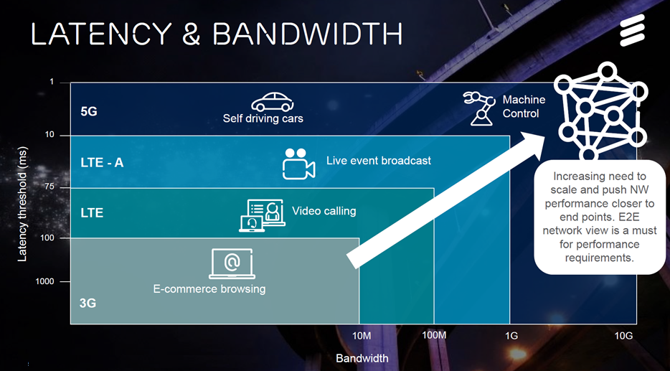


Slide 14
5G main Requirements:
Transmission Rates: 20 Gbps nomadic and 1 Gbps on the move in downlink (halved in the uplink).
Latency: 0,5 ms for tactile interaction.
Capacity: targets can be as high as 15 Tbps/km2 with 250 000 users/km2 for indoor hotspots such as office environments.
Spectral Efficiency
  Downlink 30bit/s/Hz - services require more in the downlink
  Uplink 15bit/s/Hz - uplink is the bottleneck, due to lower Tx Power, and lower number of Tx antenas, …

Slide 15
HOW TO ACHIEVE 5G?
Massive MIMO
Millimeter Waves
Base Station Coperation
Multi-hop Relay
All-over IP
Adaptive Modulation & Coding
Multi-Resolution Techniques
Carrier Aggregation
OFDM & Other Block Transmission Techniques
Introduction: 5G Communications

Slide 16
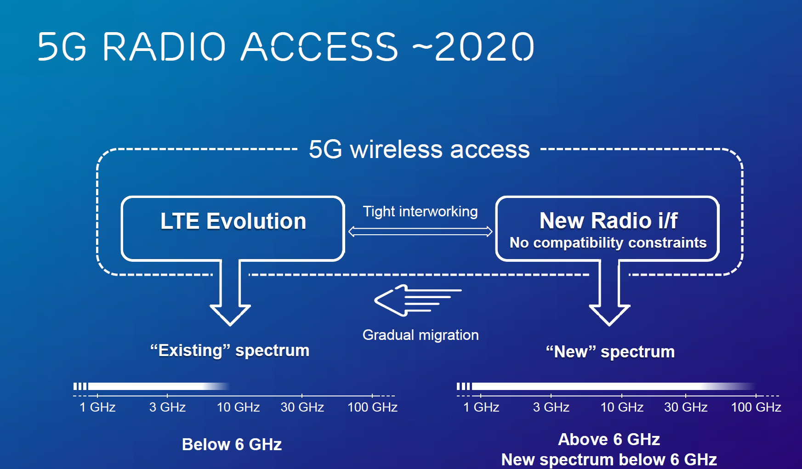

Slide 17
Introduction: 5G Communications
Massive MIMO
Hundreds or Thousands of Tx and Rx Antennas
Complexity grows Exponentially => Signal Processing
mm-Wave facilitates m-MIMO, as distance between antenas is reduced

Slide 18
Introduction: 5G Communications
mm-Wave communications (30-300GHz - EHF) are expected to be a crucial part of 5G systems due to their increased channel coherence bandwidth, as compared to centimeter Wave. These systems use carrier frequencies of 30 - 70 GHz, where we have large unoccupied bandwidth. – E.g.: IEEE802.11ad uses 2.16 GHz of BW in 60 GHz band (ISM band), supporting up to 7 Gbps.
The distance between antennas is reduced, facilitating a higher number of antenna elements (Massive MIMO)
However, mm-Wave suffers from high path loss and rain and oxygen absorption.
mm-Wave and Massive MIMO

Slide 19
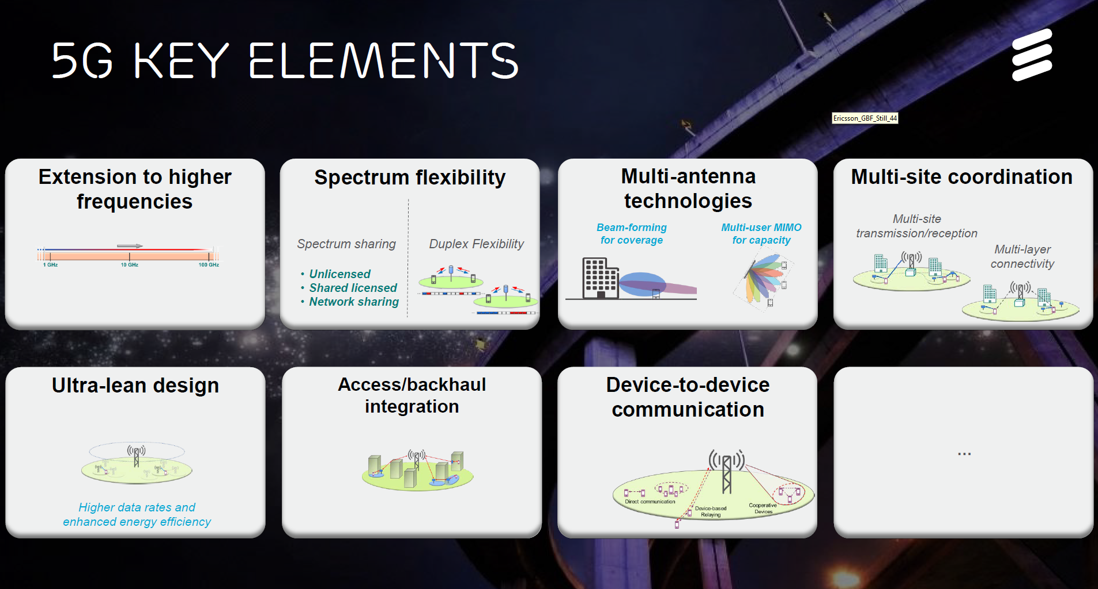

Slide 20
Conclusions
5G is expected by 2020, supporting the following improvement, as compared to 4G:
  Transmission Rates 20 times higher (20 Gb/s for nomadic access)
  Lattency 10 times lower (0,5-1 ms)
  Point-to-point communications (similar to TETRA, p.e.), supporting Internet of Things, Virtual Reality and Self Driving Cars.
Supported in Massive-MIMO.
Incorporating millimetric Waves (has higher bandwidth) and also facilitate the implementation of Massive-MIMO (in Research).
Other techniques, such as Base-Station Cooperation, Multi-Hop Relay, Multi-Resolution Techniques, Block Transmission Techniques (e.g., OFDM), Carrier Agreggation, AMC, etc., also contribute to support the improvement of 5G (in Research).
Increased transmission rates result from the optimized conjugation of different transmission techniques.

Slide 21
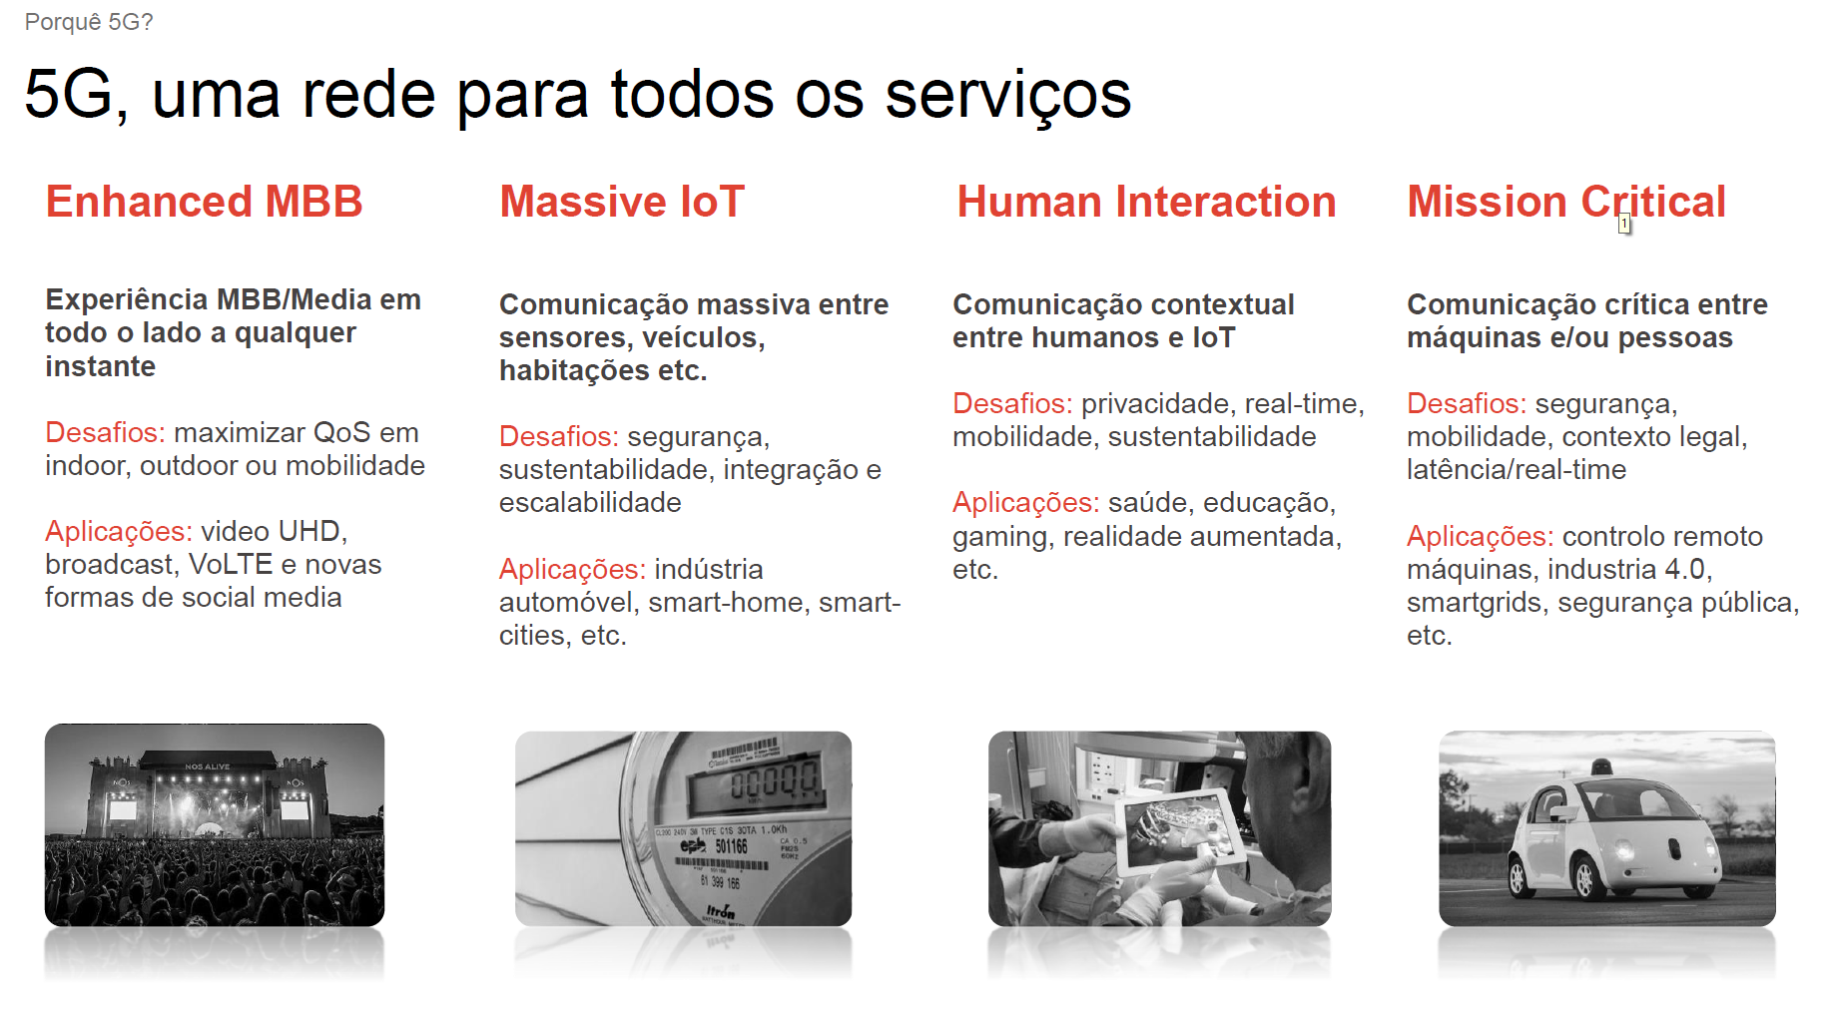

Slide 22
Outline
Introduction: the 4th Industrial Revolution & 5G Communications
Channel Estimation for Massive MIMO using Precoding
Performance Results
Conclusions

Slide 23
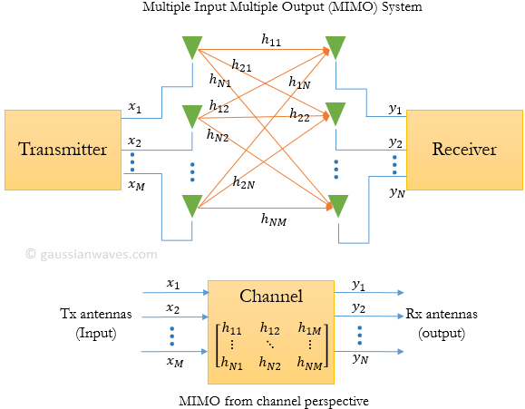
MOTIVATION
Develop a Channel Estimation for a Simplified Massive MIMO system (applied to 5G Communications)

Slide 24
Motivation
This work proposes a new channel estimation scheme based on implicit pilots, optimized for a simplified MIMO, implemented with precoding.
The channel estimates are usually obtained with the help of pilot symbols and/or training sequences multiplexed with data symbols. Since the required overheads in massive MIMO schemes can be too high, leading to spectral degradation, the use of superimposed pilots (i.e., pilots added to data) is an efficient alternative.
Three different types of pre-processing algorithms are considered in this paper: Zero Forcing Transmitter (ZFT), Maximum Ratio Transmitter (MRT), and Equal Gain Transmitter (EGT).
The main advantage of MRT and EGT is that they do not require matrix inversions.
Nevertheless, some level of interference is generated in the decoding process.
Such interference is mitigated by employing an optimized iterative receiver.

Slide 25
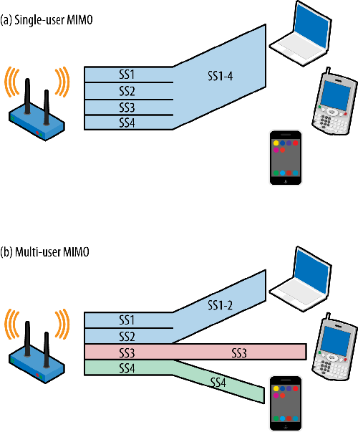
Multi-User MIMO
SU-MIMO considers data being transmitted from a single user into another individual user (widely used in the uplink)
Alternatively, MU-MIMO considers multiple streams of data sent by a single transmitter (typically a BS) simultaneously allocated to a certain user to increase throughput (or to multiple users to increase capacity), using the same frequency bands (and the Tx supports more antennas than the Rx)
  When the aim is improved performance, instead of different streams of data, STBC or STD is employed
The approach behind MU-MIMO is similar to SU-MIMO multi-layer transmission. Nevertheless, while multi-layer Tx (or SDMA) is typically employed in the uplink, the MU-MIMO is widely implemented in the downlink
In this case, instead of performing the nulling algorithm at the receiver side, the nulling algorithm needs to be performed using a pre-processing approach at the transmitter side (BS)
  Number of Tx antennas (BS) must be equal to or higher than the number of Rx antennas (MT)
  Use pre-coding such as ZF, MMSE, dirty paper, etc. (we propose MRC/EGC)
This typically requires downlink CSI at the Tx side (in FDD)
Similar concept can be employed in Base Station Cooperation (Coordinated Multi-Point Transmission) and in Multihop Relaying to improve SNR or throughput at the cell edge

Slide 26


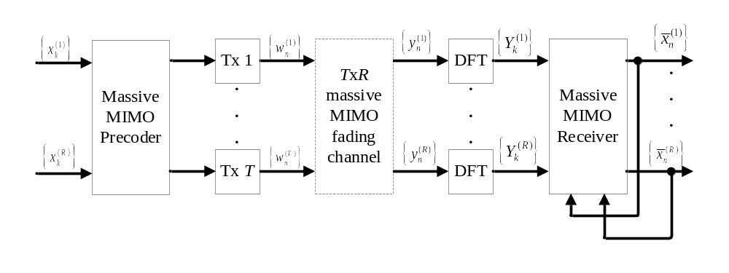
System Characterization for m-MIMO using Precoding
Transmission between a BS with T antennas and a MS with R antennas, to send R multiple streams of data.
T≫R
[1] M. Marques da Silva, R. Dinis, “A Simplified Massive MIMO Implemented with Pre or Post-Processing”, Physical Communications, Elsevier, Physical Communication-Elsevier Vol. 1, Nº 1, pp. 1-12, September, 2017, http://dx.doi.org/10.1016/j.phycom.2017.06.002

Slide 27
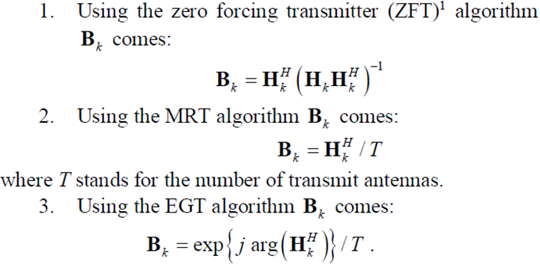
System Characterization for m-MIMO using Precoding
Matrix
inversion
[1] M. Marques da Silva, R. Dinis, “A Simplified Massive MIMO Implemented with Pre or Post-Processing”, Physical Communications, Elsevier, Physical Communication-Elsevier Vol. 1, Nº 1, pp. 1-12, September, 2017, http://dx.doi.org/10.1016/j.phycom.2017.06.002

Slide 28
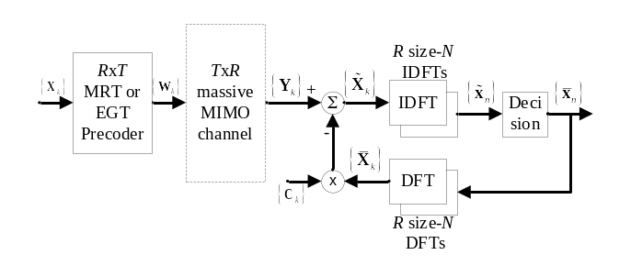




System Characterization for m-MIMO using Precoding
To overcome interference of MRT and EGT, we propose the iterative interference canceller (receiver), defined by:
Where the replica of interference estimate, for subtraction is
With denoting the frequency-domain average values conditioned to the FDE output for the previous iteration.
[1] M. Marques da Silva, R. Dinis, “A Simplified Massive MIMO Implemented with Pre or Post-Processing”, Physical Communications, Elsevier, Physical Communication-Elsevier Vol. 1, Nº 1, pp. 1-12, September, 2017, http://dx.doi.org/10.1016/j.phycom.2017.06.002

Slide 29
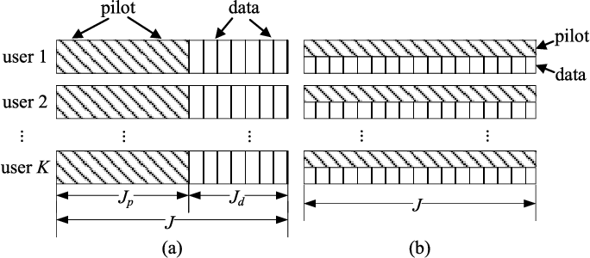
System Characterization for m-MIMO using Precoding
We have interference between data symbols and pilots, which leads to performance degradation.
To overcome this problem, we can employ pilots with relatively low power and average the pilots over a large number of blocks so as to obtain accurate channel estimates.
This is very effective since the data symbols have usually zero mean and different data blocks are uncorrelated.

Slide 30
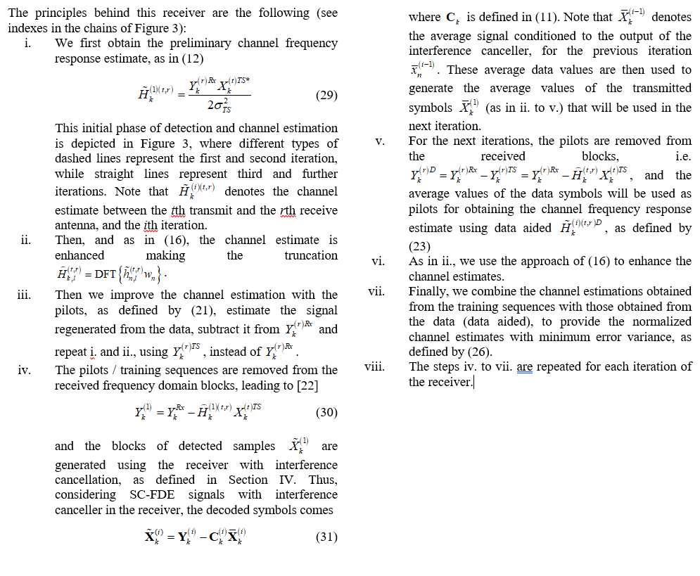
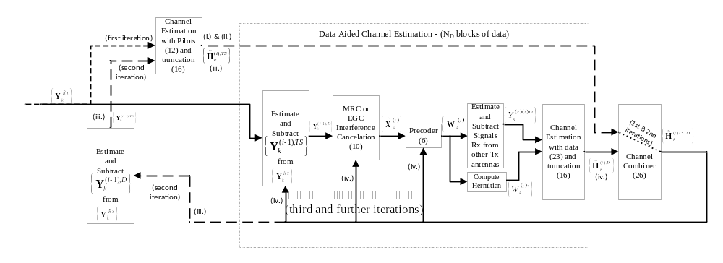
Block Diagram of m-MIMO Receiver with Interference Canceller and Channel Estimation, using Pre-Processing

Slide 31
Block Diagram of m-MIMO Receiver with Interference Canceller and Channel Estimation, using Pre-Processing

Slide 32
Outline
Introduction: the 4th Industrial Revolution & 5G Communications
Channel Estimation for Massive MIMO using Precoding
Performance Results
Conclusions

Slide 33
Performance Results
We present a set of performance results (Monte Carlo simulations) concerning the proposed m-MIMO scheme optimized for mm-wave associated to SC-FDE signals using precoding (pre-processing).
Each block has N = 256 symbols selected from a QPSK constellation.
Our channel has 16 equal power paths with uncorrelated Rayleigh fading.

Slide 34
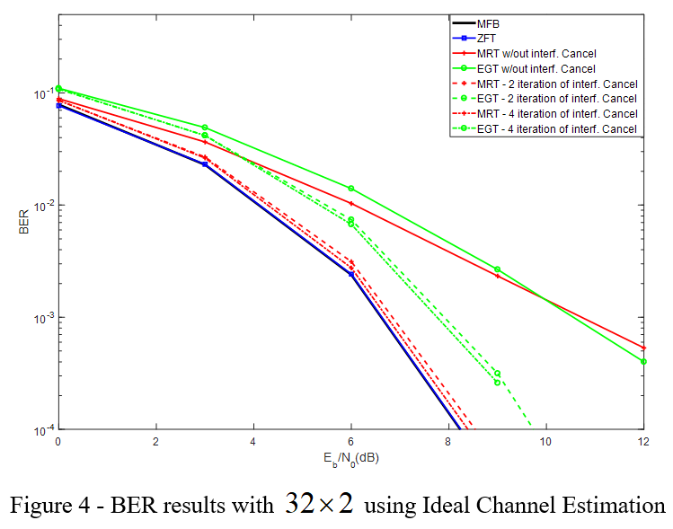
Performance Results
32x2 - 2 parallel streams of data

Slide 35
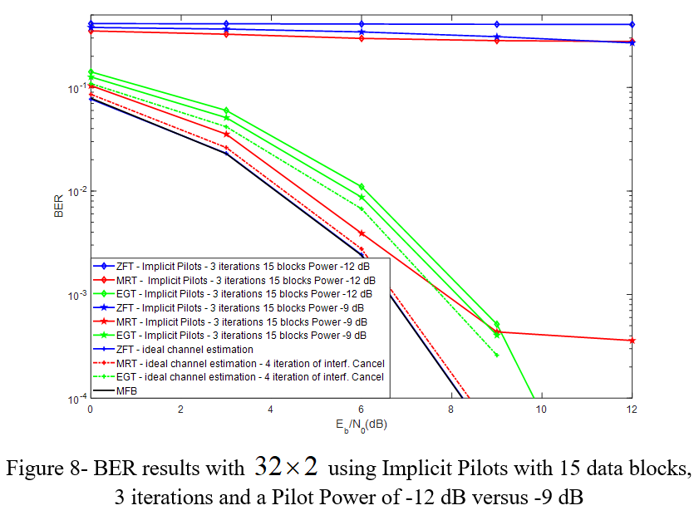
Performance Results

Slide 36
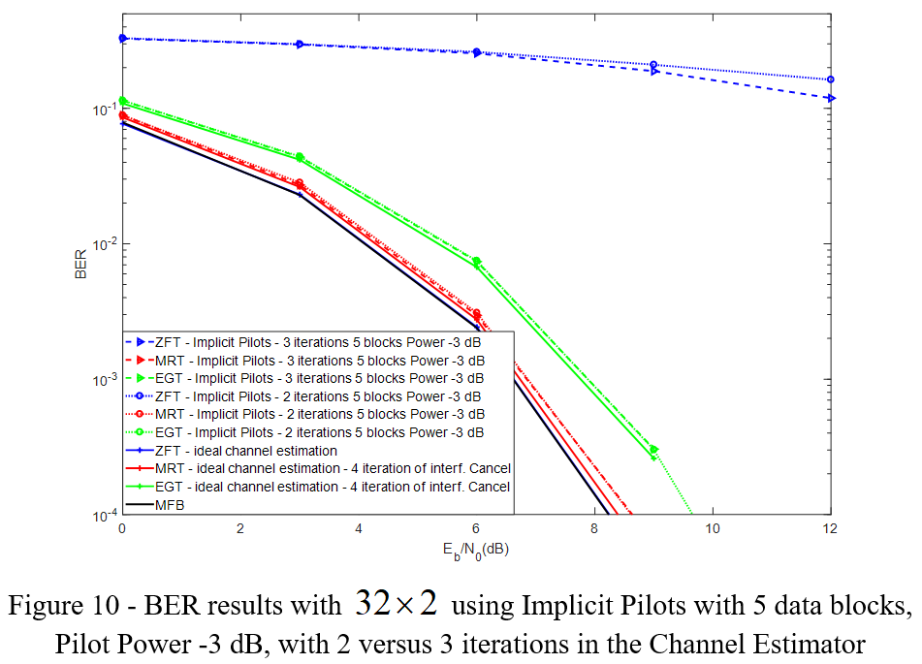
Performance Results

Slide 37
Outline
Introduction: the 4th Industrial Revolution & 5G Communications
Channel Estimation for Massive MIMO using Precoding
Performance Results
Conclusions

Slide 38
Conclusions
The channel estimation using implicit pilots for m-MIMO system was considered (precoding approach).
By using the MRT and EGT we avoid the need to compute the pseudo-inverse of the channel matrix (ZF algorithm).
Since with MRT and EGT, a certain level of interference is generated, a novel iterative interference canceller was proposed.

Slide 39
Conclusions
A performance very close to the MFB is achieved with MRC, especially with 4 iterations of the interference canceller.
While the ZFT is the scheme that achieves the best overall performance under ideal channel estimation conditions, by considering channel estimation (unideal channel estimation), the ZFT degrades heavily, while the MRC tends to perform better.

Slide 40
References
[1] M. Marques da Silva, R. Dinis, “A Simplified Massive MIMO Implemented with Pre or Post-Processing”, Physical Communications, Elsevier, Physical Communication-Elsevier Vol. 1, Nº 1, pp. 1-12, September, 2017, http://dx.doi.org/10.1016/j.phycom.2017.06.002
[2] Mário Marques da Silva, Rui Dinis, “A Simplified Massive MIMO Approach using Precoding”, 2017 IEEE International Conference on Computer and Information Technology (CIT-2017), Helsinki, Finland, 21-23 August 2017.
[3] Guilherme Gaspar, Afonso Ferreira, Paulo Montezuma, Mario Marques da Silva and Rui Dinis, "An Iterative Decision Directed Channel Estimation for Multi-user MIMO Systems", 38th Progress In Electromagnetics Research Symposium 2017 (PIERS 2017), Saint Petersburg, Russia, 21-25 May 2017
[4] Mário Marques da Silva, Rui Dinis, Paulo Montezuma, "A Comparison of Massive MIMO using Pre and Post-Processing", 38th Progress In Electromagnetics Research Symposium 2017 (PIERS 2017), Saint Petersburg, Russia, 21-25 May 2017

Slide 41
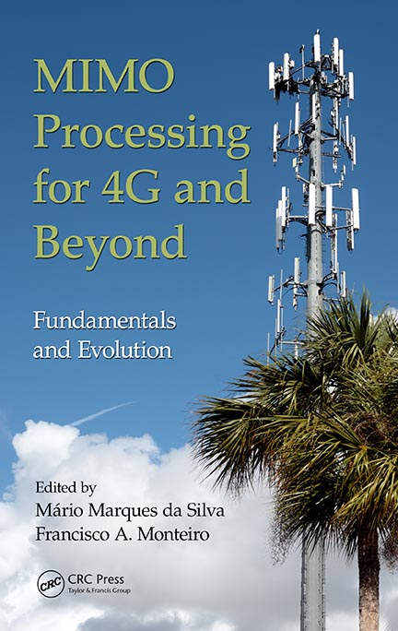
Book: MIMO processing for 4G and beyond (crc press)

Slide 42

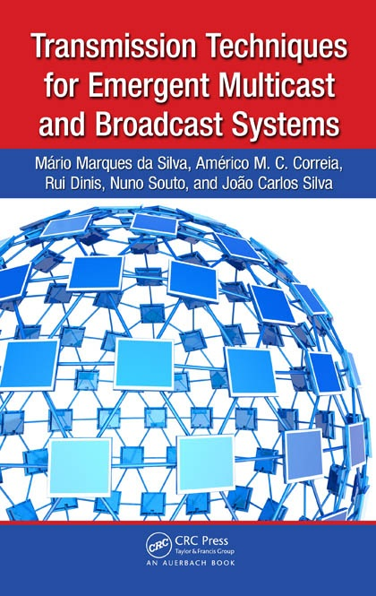
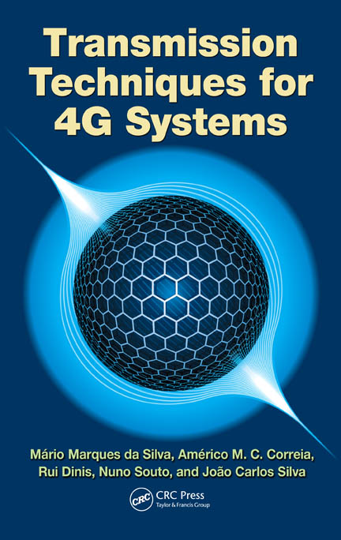
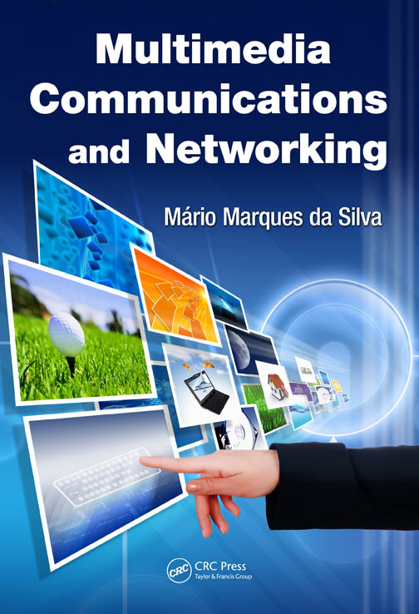

Slide 43
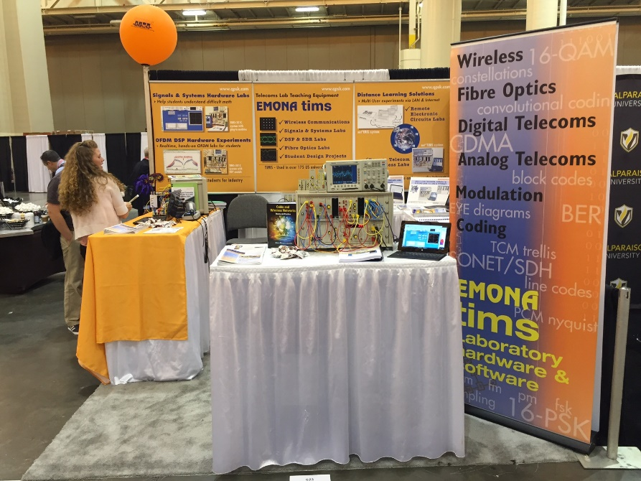
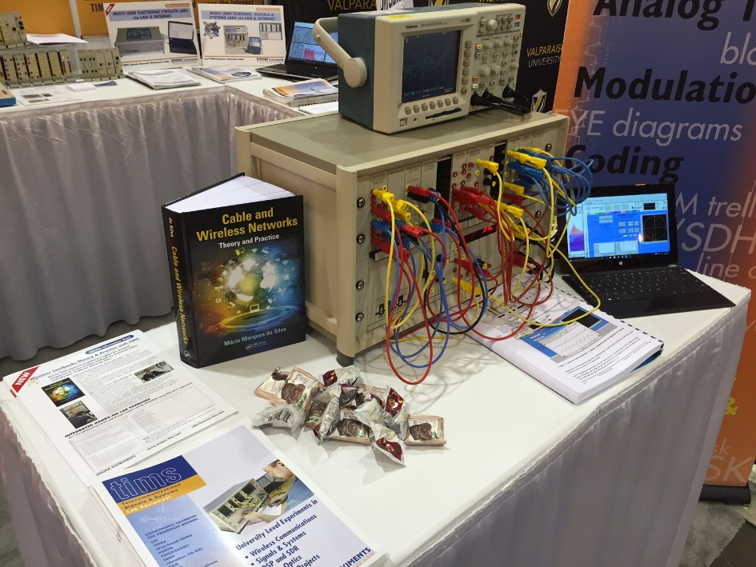
Book: cable and wireless networks: Theory & practice (crc Press)

Slide 44

Book: cable and wireless networks: Theory & practice (crc Press)

Slide 45
THANK YOU

