Slide 1


Slide 2


Mário Marques da Silva
Associate Professor at Universidade Autónoma de Lisboa
Director of the Department of Sciences and Technologies
Researcher at Instituto de Telecomunicações
mmsilva@autonoma.pt
The Evolution of 5G Communications within the scope of the Fourth Industrial Revolution

Slide 3
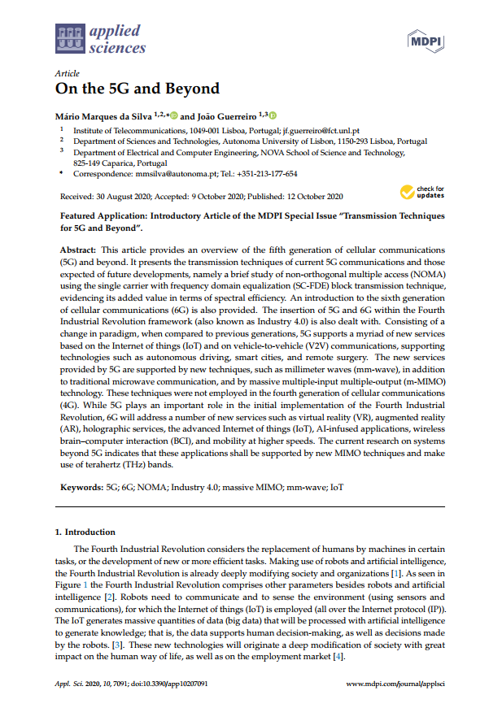
Main Reference
M. Marques da Silva, J. Guerreiro, “On the 5G and Beyond”, MDPI Applied Sciences, 10, 7091, 26 October 2020 (https://www.mdpi.com/2076-3417/10/20/7091)

Slide 4
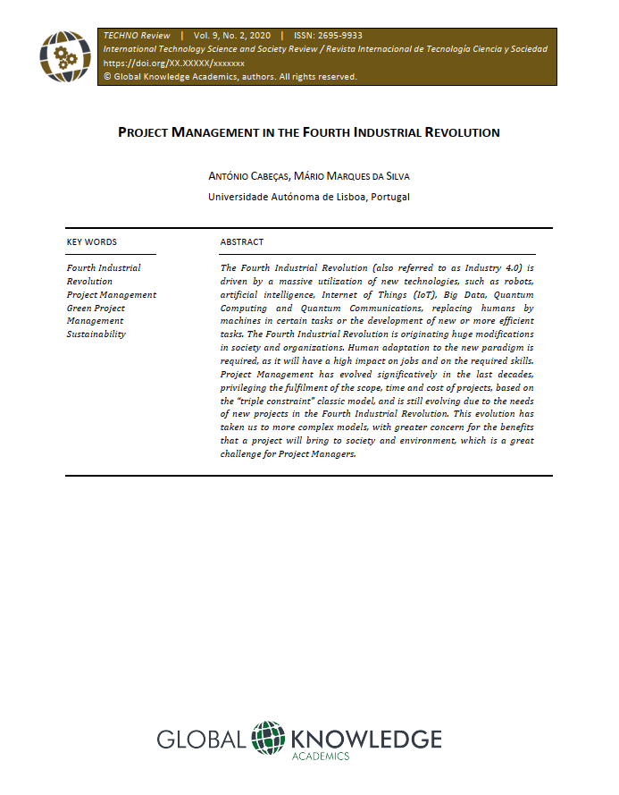
Main Reference
A. Cabeças, M. Marques da Silva, “Project Management in the Fourth Industrial Revolution”, TECHNO REVIEW, International Technology, Science and Society Review, 9(2), 11 January 2021, pp. 79-96. https://doi.org/10.37467/gka-revtechno.v9.2804

Slide 5
The Evolution of 5G Communications within the scope of the Fourth Industrial Revolution
Agenda
      The Digital Transformation
      5G Communications
      Future Evolutions & NOMA
      6G Communications

